Slide 1


Oral Communication Skills A
(CELEN069)
Core Unit 5
Technology and society
Lesson 9.1

Slide 2
Lesson aims and objectives
By the end of this lesson, you should have enhanced your speaking and listening ability through practice.
In addition, you should be better able to … | Intended Learning Outcomes
select and note information from a lecture relevant to a particular purpose | 1.1-1.6 2.7 3.3-3.6
use selected information from a lecture for research purposes

Slide 3

Getting started

Slide 4
Getting started: Headlines
Your tutor will assign you a letter: A or B.
Students A: Go to the 'A' wall. Look at the headlines and discuss them with other students A.
Students B: Go to the 'B' wall. Look at the headlines and discuss them with other students B.
When you have finished, choose a number on the scale below.
Then, return to your table and discuss the question below in groups. Agree on a number on the scale with justification.
Has the impact of social media on society been more positive or negative?
negative
neutral
positive
-5
-4
-3
-2
-1
0
1
2
3
4
5

Slide 5

Preparing for the lecture

Slide 6

Preparing for the lecture: Vocabulary building (A)
Check your answers to the homework task.
1 | It is impossible to avoid social media since it permeates every aspect of modern life.
 | (a) gives a sense of understanding to something |  | (b) helps to improve something |  |  | (c) spreads throughout all or most of something
2 | The emergence of the Internet in the early 21st century changed the way we learn.
 | (a) growth to a position of importance or influence | (b) replacement of something outdated |  |  |  | (c) the opinions held by a large number of people
3 | It can seem that modern technology use is much more intuitive to younger people.
 | (a) based on understanding complex ideas |  |  |  | (b) based on natural feeling or sense |  | (c) based on large amounts of research
4 | Smart phone addiction is one negative outcome of modern technology.
 | (a) the way something is designed |  |  | (b) the result of a process |  |  | (c) the cause of a problem
5 | Cases of online bullying resonate with people who have suffered from it themselves.
 | (a) produce strong feelings due to similar experience | (b) produce negative behaviour |  |  |  | (c) create understanding of a new situation

Slide 7
Preparing for the lecture: Vocabulary building (A)
6 | In airports, facial recognition is often used to verify a person’s identity.
 | (a) understand more about something |  |  |  | (b) provide an example of something |  |  |  | (c) confirm as true or real
7 | Looking at general trends in society helps to contextualise a person’s smartphone habits.
 | (a) make something clear or obvious |  | (b) view something in its wider situation |  |  |  |  | (c) provide support or evidence
8 | A lot of people don’t utilise all the functions of their smartphones.
 | (a) spend time doing something important |  |  | (b) help develop a product or idea |  |  | (c) make full and effective use of something
9 | Each participant in the study had to live without a mobile phone for one week.
 | (a) a person taking part in an organized activity |  |  | (b) a person who organizes an activity |  |  | (c) a person observing an organized activity
10 | It is helpful to reassure people that new technology is designed to be simple to use.
 | (a) give people confidence by removing doubts or fears | (b) teach people how to do or use something |  |  |  | (c) provide support to someone in a new situation

Slide 8
Preparing for the lecture: Vocabulary building (B)
Check your answers to the homework task.
1 | The music industry changed dramatically due to the emergence of online streaming. (when … emerged)
 | The music industry changed dramatically when online streaming emerged.
2 | Studies suggest learning basic mathematics may be an intuitive process. (based on intuition)
 | Studies suggest learning basic mathematics may be a process based on intuition.
3 | Online reviews make it much easier to verify advertising claims about products. (the verification of)
 | Online reviews make the verification of advertising claims about products much easier.
4 | Evaluations of educational technology must be contextualized in real learning situations. (put in the context)
 | Evaluations of educational technology must be put in the context of real learning situations.
5 | We are more likely to buy new technology if salespeople reassure us that other people are buying it. (get reassurance)
 | We are more likely to buy new technology if we get reassurance from salespeople that other people are buying it.

Slide 9
Preparing for the lecture: Listening and note-taking focus
Listening for a specific purpose
Effective listening skills involve having a purpose behind the listening activity.
Having a purpose when listening can help you focus on the content. It can also help you choose which information is relevant to your purpose and which is not. Not all information from a lecture/ video may be relevant to your listening purpose.
Look at the situations below and decide what might be the listening purpose.
Listening to a timetabled lecture (e.g. one of your Content lectures)
Watching the recording of a lecture you’ve already attended
Watching a video from a reading list
Watching a video you found online
Possible listening purpose:
Learning something new about a topic
Reviewing notes and adding information
Finding specific information relevant to an assignment

Slide 10

Preparing for the lecture: Listening and note-taking focus
Imagine you were asked to give a short presentation. Listen to the lecture extract and make notes that would help you answer your assigned presentation topic below.
Students A:
Students B:
‘Skills for the future workplace’
‘Negative impact of social media on society’
Students A compare your notes with Students B. Are they the same or different?

Slide 11

Listening to the lecture

Slide 12
Listening to the lecture: Lecture content focus
Imagine that you are preparing a short presentation on the following topic:
What has been the impact of social media in education?
In groups, brainstorm 2-3 impacts of social media in education. Explain your ideas.

Slide 13
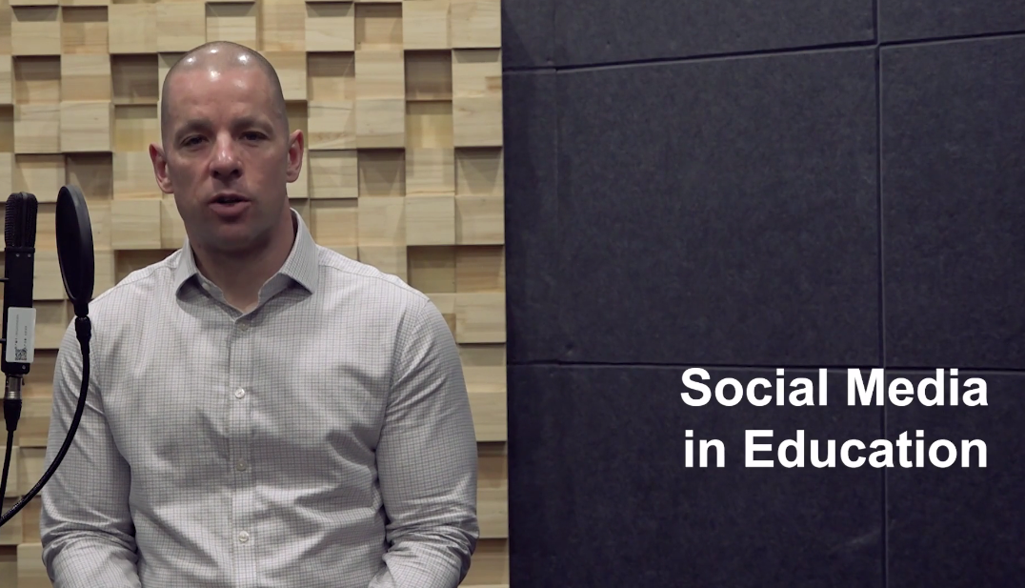
Listening to the lecture: Lecture content focus
You are going to watch Lecture 5A ‘Social media in education’.
As you watch the lecture, write down information that will help you answer the presentation question.
What has been the impact of social media in education?
Listening for a specific purpose
Not all information from the lecture may be relevant to your listening purpose.

Slide 14
Listening to the lecture: Comprehension check - Main ideas
According to the lecture, what are the two negative and the two positive impacts of social media?
Negative impacts
Poorer academic outcomes
Students are looking for bite sized pieces of information
Positive impacts
Improved learning through increased collaboration and communication
Students can use it as a support network

Slide 15
Listening to the lecture: Comprehension check - Details
What further information does the lecture provide on each impact of social media?
Impacts of social media | Further information (suggested answers)
Poorer academic outcomes | (Research suggests that) almost 60% of Middle Eastern university students are addicted to social media, which impacts on assignments, face-to-face communication and sleep time. (Research refers to) time wasted amongst high school students.
Students are looking for bite sized pieces of information | Students are not using verified books and journals. Students are becoming less informed and less able to process complex information.
Improve learning through increased collaboration and communication | Social Learning Theory = learning takes place through interactions. (Academics argue that) social media platforms should be used as a learning space. Students interacting online about group assignments tend to perform better.
Students can use it as a support network | e.g. using the class WeChat group for sharing resources and information. Social media can be used for emotional support.

Slide 16

Developing the topic

Slide 17
Developing the topic: Poster presentation
You have information from both the Social media use survey (completed for homework) and today’s lecture.
Work as a team of 3 or 4. Compare your findings from the survey to the information in the lecture. Look for trends and information of interest.
Use the information to create a poster on A3 paper to answer the question below. All team members will be expected to present the poster, so make sure you are ready!
What has been the impact of social media in education?
When you’ve finished the poster, place it on one of the classroom walls.

Slide 18
Developing the topic: Poster presentation
Get into THREE big groups. Each group should have at least one member from each of the poster making teams.
Each group should choose one of the posters and go stand next to it.
When ready, the team member(s) who created the poster should present it to the rest of the group. The audience should ask questions (it should be interactive).
After 2 minutes, all groups should move to the next poster (clockwise).
Repeat until each group has ‘visited’ each of the posters.

Slide 19

Homework (explained)
Due | Task
Lesson 9.2 | Watch the assigned video (1-4) and answer the focus question related to that video on the Class workbook (Lesson 9.2).
Video 1: Retail 2020 | 5 Technologies that will change the way you shop
Focus question: How can data be used to make shopping in stores more convenient in the future?
Video 2: Inside Alibaba: How New Retail Is Changing Everything
Focus question: In what ways is Alibaba leading innovation in supermarkets and fashion retail?
Video 4: E-commerce live streaming, $63B industry, explained
Focus question: Why has live streaming been so successful, and what is the future of livestreaming?
Video 3: The Future of Shopping
Focus question: How will shopping in the fashion industry change in the future?

Slide 20



Week 9
Extra resources for OCSa this week on the Writing Lab Moodle page:
Speaking → University speaking tasks (group discussions)
Next week (Week 9 – beginning the 2nd of December):
Utalk continues! Monday → Friday PB 115.
Evening sessions available (check SPDPO system for times)
NEW!
Extra group discussion practice (with feedback)
Sign up via the Writing Lab Friday email.
Centre for English Language Education CELE N048 AY 24-25

